Slide 1
Computer Organization and Architecture
Lecture16 Memory(I)-SRAM & DRAM

Slide 2
Today’s Topic
00
01. Introduction
02. SRAM
03. DRAM Device
04. Memory Subsystem

Slide 3
The Big Picture: Where are We Now?
01
The Five Classic Components of a Computer
Today’s Topics:
SRAM Memory Technology
DRAM Memory Technology
Memory Organization
Processor
Input
Control
Memory
Datapath
Output

Slide 4
Random Access Memory (RAM) Technology
1.2
Why do computer designers need to know about RAM technology?
Processor performance is usually limited by memory bandwidth
As IC densities increase, lots of memory will fit on processor chip
Tailor on-chip memory to specific needs
Instruction cache
Data cache
Write buffer
What makes RAM different from a bunch of flip-flops?
Density: RAM is much denser

Slide 5
Today’s Topic
00
01. Introduction
02. SRAM
03. DRAM Device
04. Memory Subsystem

Slide 6
Static RAM (SRAM) Cell
2.1
6-Transistor SRAM Cell
word
word
(row select)
0
1
0
1
bit
bit
Write:
1. Drive bit lines (bit=1, bit=0)
2. Select row
Read:
1. Precharge bit and bit to Vdd or Vdd/2 => make sure equal!
2.. Select row
3. Cell pulls one line low
4. Sense amp on column detects difference between bit and bit
bit
bit
replaced with pullup
to save area

Slide 7
Typical SRAM Organization: 16-word x 4-bit
2.2
Din 3
Din 2
Din 1
Din 0
WrEn
Precharge
Wr Driver &
Precharger
Wr Driver &
Precharger
Wr Driver &
Precharger
Wr Driver &
Precharger
-
+
-
+
-
+
-
+
Word 0
A0
SRAM
Cell
SRAM
Cell
SRAM
Cell
SRAM
Cell
A1
Address Decoder
Word 1
A2
SRAM
Cell
SRAM
Cell
SRAM
Cell
SRAM
Cell
A3
:
:
:
:
Word 15
SRAM
Cell
SRAM
Cell
SRAM
Cell
SRAM
Cell
-
+
-
+
-
+
-
+
Q: Which is longer:
word line or
bit line?
Sense Amp
Sense Amp
Sense Amp
Sense Amp
Dout 3
Dout 2
Dout 1
Dout 0

Slide 8
Logic Diagram of a Typical SRAM
2.3
Write Enable is usually active low (WE_L)
A
2
N
N
words
WE_L
x M bit
SRAM
Din and Dout are combined to save pins:
OE_L
D
M
A new control signal, output enable (OE_L) is needed
WE_L is asserted (Low), OE_L is disasserted (High)
D serves as the data input pin
WE_L is disasserted (High), OE_L is asserted (Low)
D is the data output pin
Both WE_L and OE_L are asserted:
Result is unknown. Don’t do that!!!

Slide 9
Typical SRAM Timing
2.4
A
2
N
N
words
WE_L
x M bit
SRAM
OE_L
D
M
Write Timing:
Read Timing:
D
Data In
High Z
Data Out
Data Out
Junk
A
Write Address
Read Address
Read Address
OE_L
WE_L
Write
Hold Time
Read Access
Time
Read Access
Time
Write Setup Time

Slide 10
Analyze the SRAM Cell
2.5
6-Transistor SRAM Cell
word
word
(row select)
0
1
P1 P2
0
1
N1 N2
bit
bit
bit
bit
An SRAM chip usually contains a great amount of word (row)
Very long bit lines => large capacitors
P1, P2, N1 and N2 must be very small
N1 and P1 have no enough energy to drive the bit line
Add a sense amplifier to compare Bit and Bit

Slide 11
Construct Register File with SRAM cells
2.6
Write new value into a cell:
drive both sides (two NMOS in red color) simultaneously
Can only write one word at every write operation
Additional bit line pair(w and w bar)
read and write can be done simultaneously

Slide 12
RF with 2 read ports and 1 write port
2.6

Slide 13
Problems with SRAM
2.7
Select = 1
P1
P2
Off
On
On
On
On
Off
N1
N2
bit = 1
bit = 0
Six transistors use up a lot of area
Consider a “Zero” is stored in the cell:
Transistor N1 will try to pull “bit” to 0
Transistor P2 will try to pull “bit bar” to 1
But bit lines are precharged to high: Are P1 and P2 necessary?

Slide 14
Today’s Topic
00
01. Introduction
02. SRAM
03. DRAM Device
04. Memory Subsystem

Slide 15
1-Transistor Memory Cell (DRAM)
3.1
row select
Write:
1. Drive bit line
2.. Select row
Read:
1. Precharge bit line to Vdd/2
2.. Select row
3. Cell and bit line share charges
Very small voltage changes on the bit line
4. Sense (fancy sense amp)
Can detect changes of ~1 million electrons
5. Write: restore the value
Refresh
1. Just do a dummy read to every cell.
bit

Slide 16
Classical DRAM Organization (square)
3.2
bit (data) lines
r
o
w
d
e
c
o
d
e
r
Each intersection represents
a 1-T DRAM Cell
RAM Cell
Array
word (row) select
row
address
Column Selector &
I/O Circuits
Column
Address
Row and Column Address together:
Select 1 bit a time
data

Slide 17
DRAM Operation: Three Steps
3.3
Precharge
Charges bit lines to know value, reqired before next row access
Row access(RAS)
decode row address, enable addressed row (often multiple Kb in row)
Contents of storage cell share charge with bitlines
Small change in voltage detected by sense amplifiers (SAs) which latch whole row bits
sense amplifiers drive bitlines full rail to recharge storage cells
Column access (CAS)
decode column address to select small number of SA latches (4,8,16 or 32 bits depending on DRAM package
on read, send latched bits out to chip pins
on write, change SA latches, which then charge storage cells to reqired value
can perform multiple column access on same row without another row access (burst mode)

Slide 18
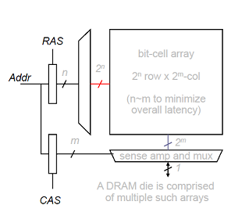
DRAM access protocol
3.4
5 basic commands
ACTIVATE
READ
WRITE
PRECHARGE
REFRESH
To reduce pin count, row and column share same address pins
RAS=Row Address Strobe
CAS=Column Address Strobe

Slide 19
DRAM Bank Operation
3.5
Access Address:
(Row 0, Column 0)
Columns
(Row 0, Column 1)
(Row 0, Column 85)
(Row 1, Column 0)
Row address 0
Row address 1
Row decoder
Rows
Row Buffer
CONFLICT !
HIT
Row 0
HIT
Empty
Row 1
Column address 0
Column mux
Column address 0
Column address 85
Column address 1
Data

Slide 20
DRAM Basic Operation
3.5
Access to an “ open row”
No need for ACTIVATE command
READ/WRITE to access row buffer
Access to a “ closed row”
If another row already active, must first issue PRECHAGE
ACTIVATE to open new row
READ/WRITE to access row buffer
Optional: PRECHARGE after READ/WRITESs finished

Slide 21
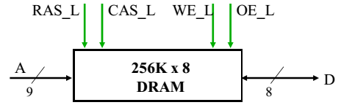
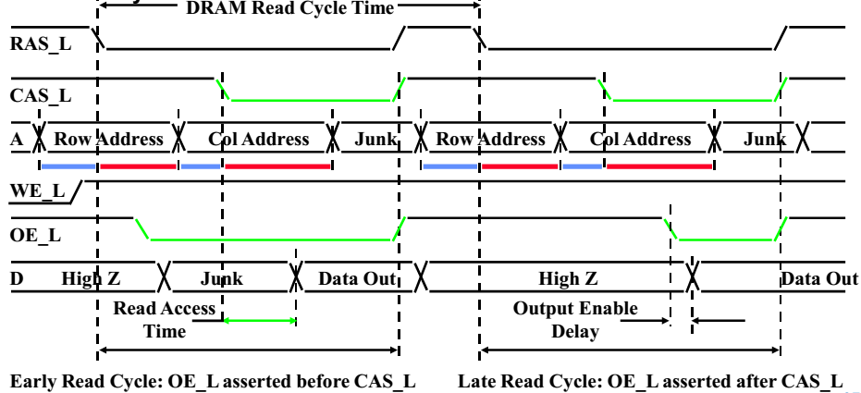
DRAM Timing--READ (Example)
3.6
Every DRAM access begins at:
The assertion of the RAS_L
2 ways to read:
Early or late v. CAS

Slide 22
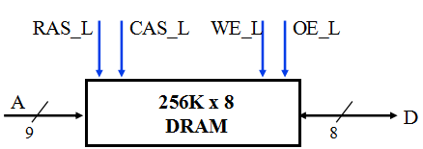
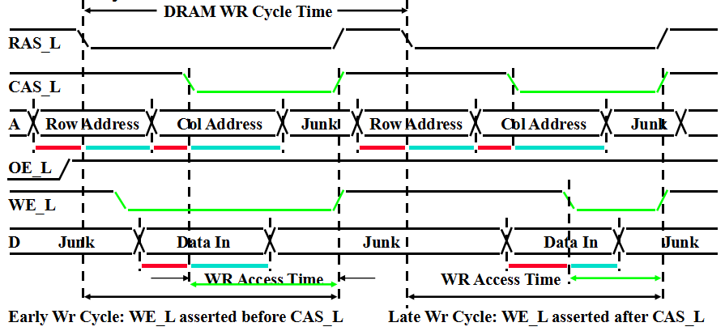
DRAM Timing-WRITE (Example)
3.6
Every DRAM access begins at:
The assertion of the RAS_L
2 ways to read:
Early or late v. CAS

Slide 23
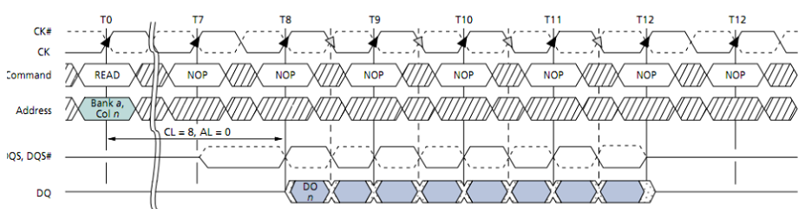
DRAM Timing-Burst
3.6
Each READ/WRITE command can transfer multiple words (8 in DDR3)
Critical word first?

Slide 24
DRAM: Banks
3.7
Modern DRAM chips consist of multiple banks
Address=(Bank x, Row y, Column z)
Banks operate independently, but share
command/address/data pins
Each can have a different row active
Can overlap ACTIVATE and PRECHARGE latencies!
(i.e. READ to bank 0 while ACTIVATING bank 1)

Slide 25
DRAM: Banks
3.7
Enable concurrent DRAM accesses (overlapping)

Slide 26
Quest for DRAM Performance
3.8
Fast Page mode
Adding timing signals that allow repeated accesses to row buffer without another row access time
Such a buffer comes naturally, as each array will buffer 1024 to 2048 bits for each access
Synchronous DRAM (SDRAM)
Add a clock signal to DRAM interface, so that the repeated transfers would not bear overhead to synchronize with DRAM controller
Double Data Rate (DDR SDRAM)
Transfer data on both the rising edge and falling edge of the DRAM clock signal => doubling the peak data rate
DDR2 lowers power by dropping the voltage from 2.5 to 1.8 volts + offers high clock rates: up to 400 MHz
DDR3 drops to 1.5 volts + high clock rates: up to 800 MHz
DDR4 drops to 1-1.2 volts + high clock rates: up to 1600 MHz

Slide 27
Fast Page Mode Operation
3.8.1
Regular DRAM Organization:
N rows x N column x M-bit
Read & Write M-bit at a time
Each M-bit access requires a RAS / CAS cycle
Fast Page Mode DRAM
N x M “SRAM” to save a row
After a row is read into the register
Only CAS is needed to access other M-bit blocks on that row
RAS_L remains asserted while CAS_L is toggled

Slide 28
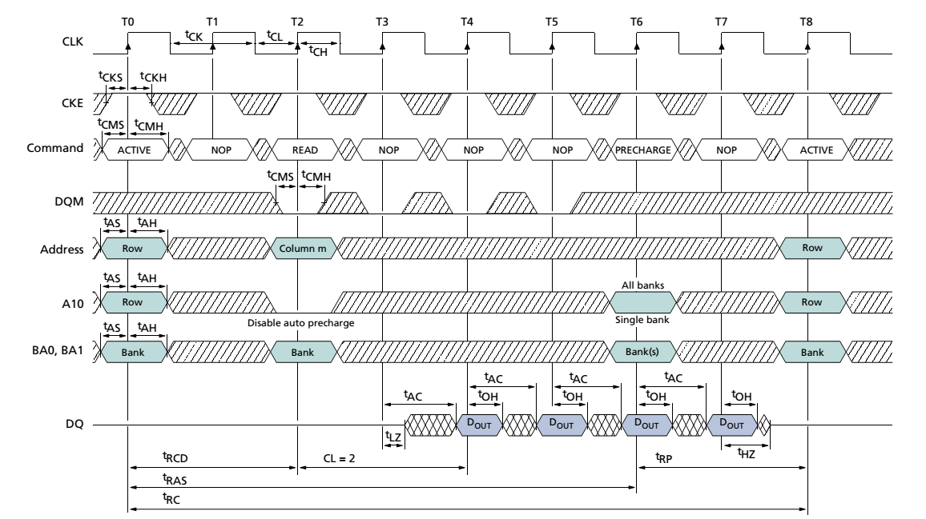
SDRAM timing (Single Data Rate)
3.8.2
Precharge
RAS
(New Bank)
CAS
Burst READ
Micron 128M-bit DRAM (Using 2Meg X 16 bit X 4 bank ver)
-Row (12 bits), bank (2 bits), Column (9 bits)

Slide 29
Double-Data-Rate (DDR2) DRAM
3.8.3
ROW
Column
Precharge
ROW
Data
[Micron, 256 Mb DDR2 Datasheet]
400 Mb/S Data Rate

Slide 30
Today’s Topic
00
01. Introduction
02. SRAM
03. DRAM Device
04. Memory Subsystem

Slide 31
Memory subsystem organization
4

Slide 32
Memory sybsystem
4

Slide 33
Breaking down a DIMM
4.1
Notes:
In computing, serial presence detect (SPD) is a standardized way to automatically access information about a memory module.
Some computers adapt to hardware changes completely automatically. In most cases, there is a special optional procedure for accessing BIOS parameters, to view and potentially make changes in settings. It may be possible to control how the computer uses the memory SPD data—to choose settings, selectively modify memory timings, or possibly to completely over-ride the SPD data. This unit is essential for modern computer memories, especially overclocking computers.

Slide 34
Breaking down a DIMM
4.1

Slide 35
Rank
4.2

Slide 36
Breaking down a Rank
4.2

Slide 37
Breaking down a Chip
4.3

Slide 38
Breaking down a Bank
4.4

Slide 39
Example: Transferring a cache block
4.5

Slide 40
Example: Transferring a cache block
4.5

Slide 41
Example: Transferring a cache block
4.5

Slide 42
Example: Transferring a cache block
4.5

Slide 43
Example: Transferring a cache block
4.5

Slide 44
Example: Transferring a cache block
4.5

Slide 45
Example: Transferring a cache block
4.5

Slide 46
DRAM Overview (DRAM Modules)
4.6

Slide 47
DRAM Modules
4.6
DRAM chips have narrow interface (typically X4, X8, X16)
Multiple chips are put together to form a wide interface
DIMM: Dual Inline Memory Module
TO get a 64-bit DIMM, we need to access 8 chips with 8-bit interfaces
Share command/address lines, but not data
Advantages
Acts like a high-capacity DRAM chip with a wide interface
8x capacity, 8x bandwidth, same latency
Disadvantages
Granularity: Accesses cannot be smaller than the interface width
8x power

Slide 48
A 64-bit Wide DIMM (physical view)
4.7

Slide 49
A 64-bit Wide DIMM (physical view)
4.8

Slide 50
DRAM Ranks
4.9
A DIMM may include multiple Ranks
A 64-bit DIMM using 8 chips with X16 interfaces has 2 ranks
Each 64-bit group of chips is called a rank
All chips in a rank respond to a single command
Different ranks share command/address/data lines
Select between ranks with “Chip Select” signal
Ranks provide more “banks” across multiple chips
(but don’t confuse rank and bank!)

Slide 51
Multiple DIMM on a Channel
4.10
Advantages
Enable even higher capacity
Disadvantages
Interconnect latency, complexity, and energy get higher
Addr/Cmd signal integrity is a challenge

Slide 52
DRAM Channels
4.11

Slide 53
DRAM Channels
4.11
Channel: a set of DIMMs in series
All DIMMs get the same command, one of the ranks replies
System options
Single channel system
Multiple dependent (lock-step) channels
Single controller with wider interface (faster cache line refill!)
Sometimes called “Gang Mode”
Only works if DIMMs are identical (organization, timing)
Multiple independent channels
Requires multiple controllers
Tradeoffs
Cost: pins, wires, controller
Benefit: higher bandwidth, capacity, flexibility

Slide 54
DRAM Channel Options
4.11

Slide 55
Memory Controller
4.12

Slide 56
DRAM：Timing Constraints
4.12
Memory controller must respect physical device characteristics
tRCD=Row to Column command delay
How long it takes row to get to sense amps
tCAS=Time between column command and data out
tCCD=Time between column commands
Rate that you can pipeline column commands
tRP=Time to precharge DRAM array
tRAS=Time between RAS and data restoration in DRAM array (minimum time a row must be open)
tRC=tRAS+tRP=Row “cycle” time
Minimum time between accesses to different rows

Slide 57
DRAM: Timing Constraints
4.12
There are dozens of these…
tWTR=Write to read delay
tWR =Time from end of last write to PRECHARGE
tFAW=Four ACTIVATE window (limits current surge)
Makes performance analysis, memory controller design difficult
Datasheets for DRAM devices freely available on website

Slide 58
Latency Components: Basic Operation
4.12
CPU-> controller transfer time
Controller latency
Queuing & scheduling delay at the controller
Access converted to basic commands
DRAM bank latency
tCAS is row “open” OR
tRCD +tCAS if array precharge OR
tRP+tRCD+tCAS (worst case:tRC+tRCD+tCAS)
DRAM data transfer time
BurstLen/(MT/S) (500MHz DDR=1000 MT/S)
Controller ->CPU transfer time

Slide 59
DRAM Addressing
4.12

Slide 60
DRAM Controller Functionality
4.12
Translate memory requests into DRAM command sequences
Map “physical Address” to DRAM Address
Obey timing constraints of DRAM, arbitrate resource confilicts (i.e. bank, channel)
Buffer and schedule requests to improve performance
Row-buffer management and re-ordering
Ensure correct operation of DRAM (refresh)
Manage power consumption and thermals in DRAM
Turn on/off DRAM chips, manage power modes

Slide 61
A Modern DRAM Controller
4.12

Slide 62
Row Buffer Management Policies
4.12
Open row
Keep the open after an access
Pro: Next access might need the same row -> row hit
Con:Next access might need a different row -> row conflict, wasted energy
Closed row
Close the row after an access ( if no other requests already in the request buffer need the same row)
Pro: Next access might need a different row -> avoid a row conflict
Con: Next access might need the same row -> extra activate latency
Adaptive policies
Predict whether or nor the next access to the bank will be to the same row

Slide 63
DRAM Controller Scheduling Policies(I)
4.12
FCFS (first come first served)
Oldest request first
FR-FCFS (first ready, first come first served)
Row-hit first
Oldest first
Goal:Maximize row buffer hit rate-> Maximize DRAM throughput

Slide 64
DRAM Controller Scheduling Policies (II)
4.12
A Scheduling Policy is a prioritization order
Prioritization can be based on
Request age
Row buffer hit/miss status
Request type (prefetch, read, write)
Requestor type (load miss or store miss)
Request criticality
Oldest miss in the core?
How many instructions in core are dependent on it?

Slide 65
DRAM Refresh (I)
4.12
DRAM capacitor charge leaks over time
The memory controller needs to read each row periodically to restore the charge
Activate + precharge each row every N ms
Typical N=64ms
Implications on Performance?
DRAM bank unavailable while refreshed
Long pause times: If we refresh all rows in burst, every 64ms the DRAM will be unavailable until refresh ends.

Slide 66
DRAM Refresh (II)
4.12
Distributed refresh eliminates long pause times
How else can we reduce the effect of refresh on performance?
Can we reduce the number of refreshes?

Slide 67
DRAM Controllers are difficult to Design
4.12
Need to obey DRAM timing constraints for correctness
There are many (50+) timing constraints in DRAM
Need to keep track of many resources to prevent conflicts
Channels, banks, ranks, data bus, address bus, row buffers
Need to handle DRAM refresh
Need to optimize for performance (in the presence of constraints)
Reordering is not simple
Predicting the future?

Slide 68
DRAM Power Management
4.13
DRAM chips have power modes
Idea: When not accessing a chip power it down
Power states
Active (highest power)
All banks idle (i.e. precharged)
Power-down
Self-refresh (lowest power)
State transitions incur latency during which the chip cannot be accessed

Slide 69
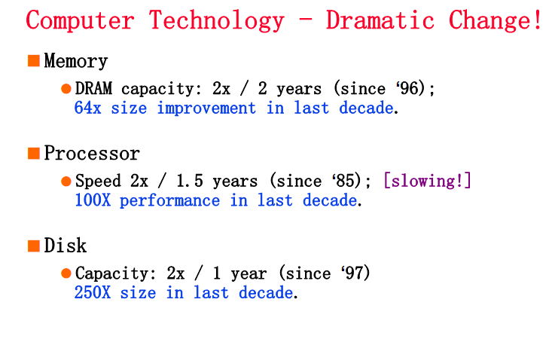
Technology Trends (from 1st lecture)
1.1

Slide 70
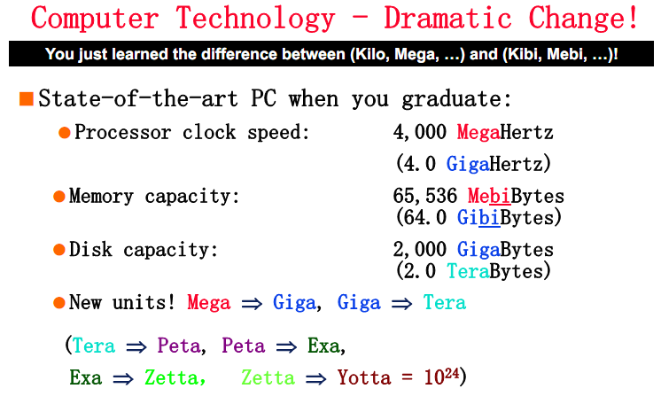
Technology Trends (from 1st lecture)
1.1

Slide 71
Who Cares About the Memory Hierarchy?
1.2

